Slide 1

Impact of Higher Education and Professional Certificates on Employment and Salary Outcomes
Ali El Masri, Pavel Makarov
May, 2024

Slide 2

Introduction
Education plays a key role in professional success
There are ways to obtain desired skills:
- Traditional education
- Online learning and certification
Does the form of education affect the salary?
Other key aspects of earning maximization
1
2
3
4

Slide 3
Problem Statement and Motivation
The quantitative impact of higher education versus professional certifications on career advancement and salary increment remains unclear.
This project aims to analyze the relative effectiveness of formal education and professional certificates in enhancing employability and earning potential within the data science sector.
The purpose of the analysis is to provide recommendations for earnings maximizations as well as building systems to analyze socio-economic factors

Slide 4

Data Sources
Data Science Survey from Kaggle
United States Census Bureau. Current Population Survey 2024

Slide 5
Data Description from Kaggle Data Science Survey
The data set has information from the surveys conducted by Kaggle about the salary, years of experience, programming language, company name, and size, and machine learning status.
The data set has 80,327 entries with the next features:
1 Unique_Id 80327 non-null int64
2 Time 80327 non-null object
3 Year 80327 non-null int64
4 Age 80327 non-null object
5 Gender 80327 non-null object
6 Country 80327 non-null object
7 Degree 80327 non-null object
8 Job Title 80327 non-null object
9 Company Size 80327 non-null object
10 Team Size 80327 non-null object
11 ML Status in Company 80327 non-null object
12 Compensation Status 80327 non-null object
13 Money Spent 80327 non-null object
14 Current role experience (in years) 80327 non-null object
15 Programming language choice 80327 non-null object
16 Recommend Programming language 80327 non-null object
17 Coding experience (in years) 80327 non-null object
18 Specialized HW 80327 non-null object
19 TPU Usage 80327 non-null object
20 ML Methods experience (in years) 80327 non-null object
From all the features 2 of them are numerical and 18 categorical

Slide 6
Data Description from Census Bureau
This data set has information from the population surveys. It covers multiple areas such as:
Employment and unemployment statistics,
Demographic data
Income and poverty statistics
Health insurance coverage
Education status
More other socioeconomic statistics
The data set has 126,784 entries with 389 columns.
All columns have numerical type of values because all responses were coded into numbers.
The data set has a supplemental data dictionary that decodes the responses from numerical values to meaningful textual data.

Slide 7
Data Preparation
Kaggle Data
Steps for data preparation:
- Removed irrelevant columns like Unique ID, Time etc.
Cleaned the response where the answer was “Unknown/Not specified”
Removed outliers from the target features
Selected features by F-statistic relevance to the target feature
Used Multiple Binarizer to encode values into numerical
CPS Data
- Imputation of missing values of family earnings where weekly earnings
- Data Filtering of highly correlated features or where non-response rates (-1) exceeded 40%.
Type Adjustments by Converting float to categorical data types and int64 to int32 for memory and computational efficiency.
Preprocessing: Implementing dimensionality reduction, scaling numerical data, and applying OneHotEncoder for categorical variables.
Mapping for visualizations

Slide 8
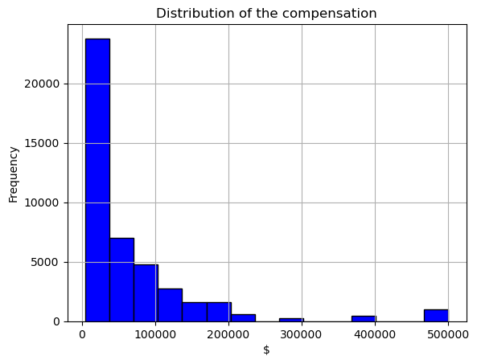
Visualizations and EDA
For supervised approach we selected the compensation as a target value
Outliers
The distribution of the compensation does not represent a normal distribution.
This helps us with further model selection and outlier detection

Slide 9
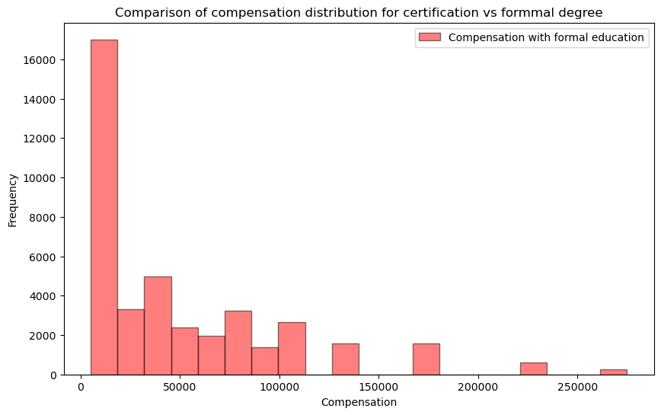
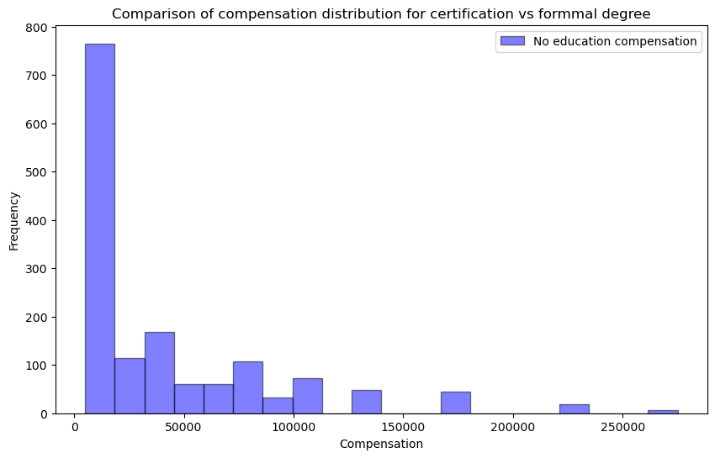
Visualizations and EDA
Comparison of distributions between responders with formal college education vs certificate or some courses
College Education
No College Education
No differences in compensation value distribution were detected

Slide 10
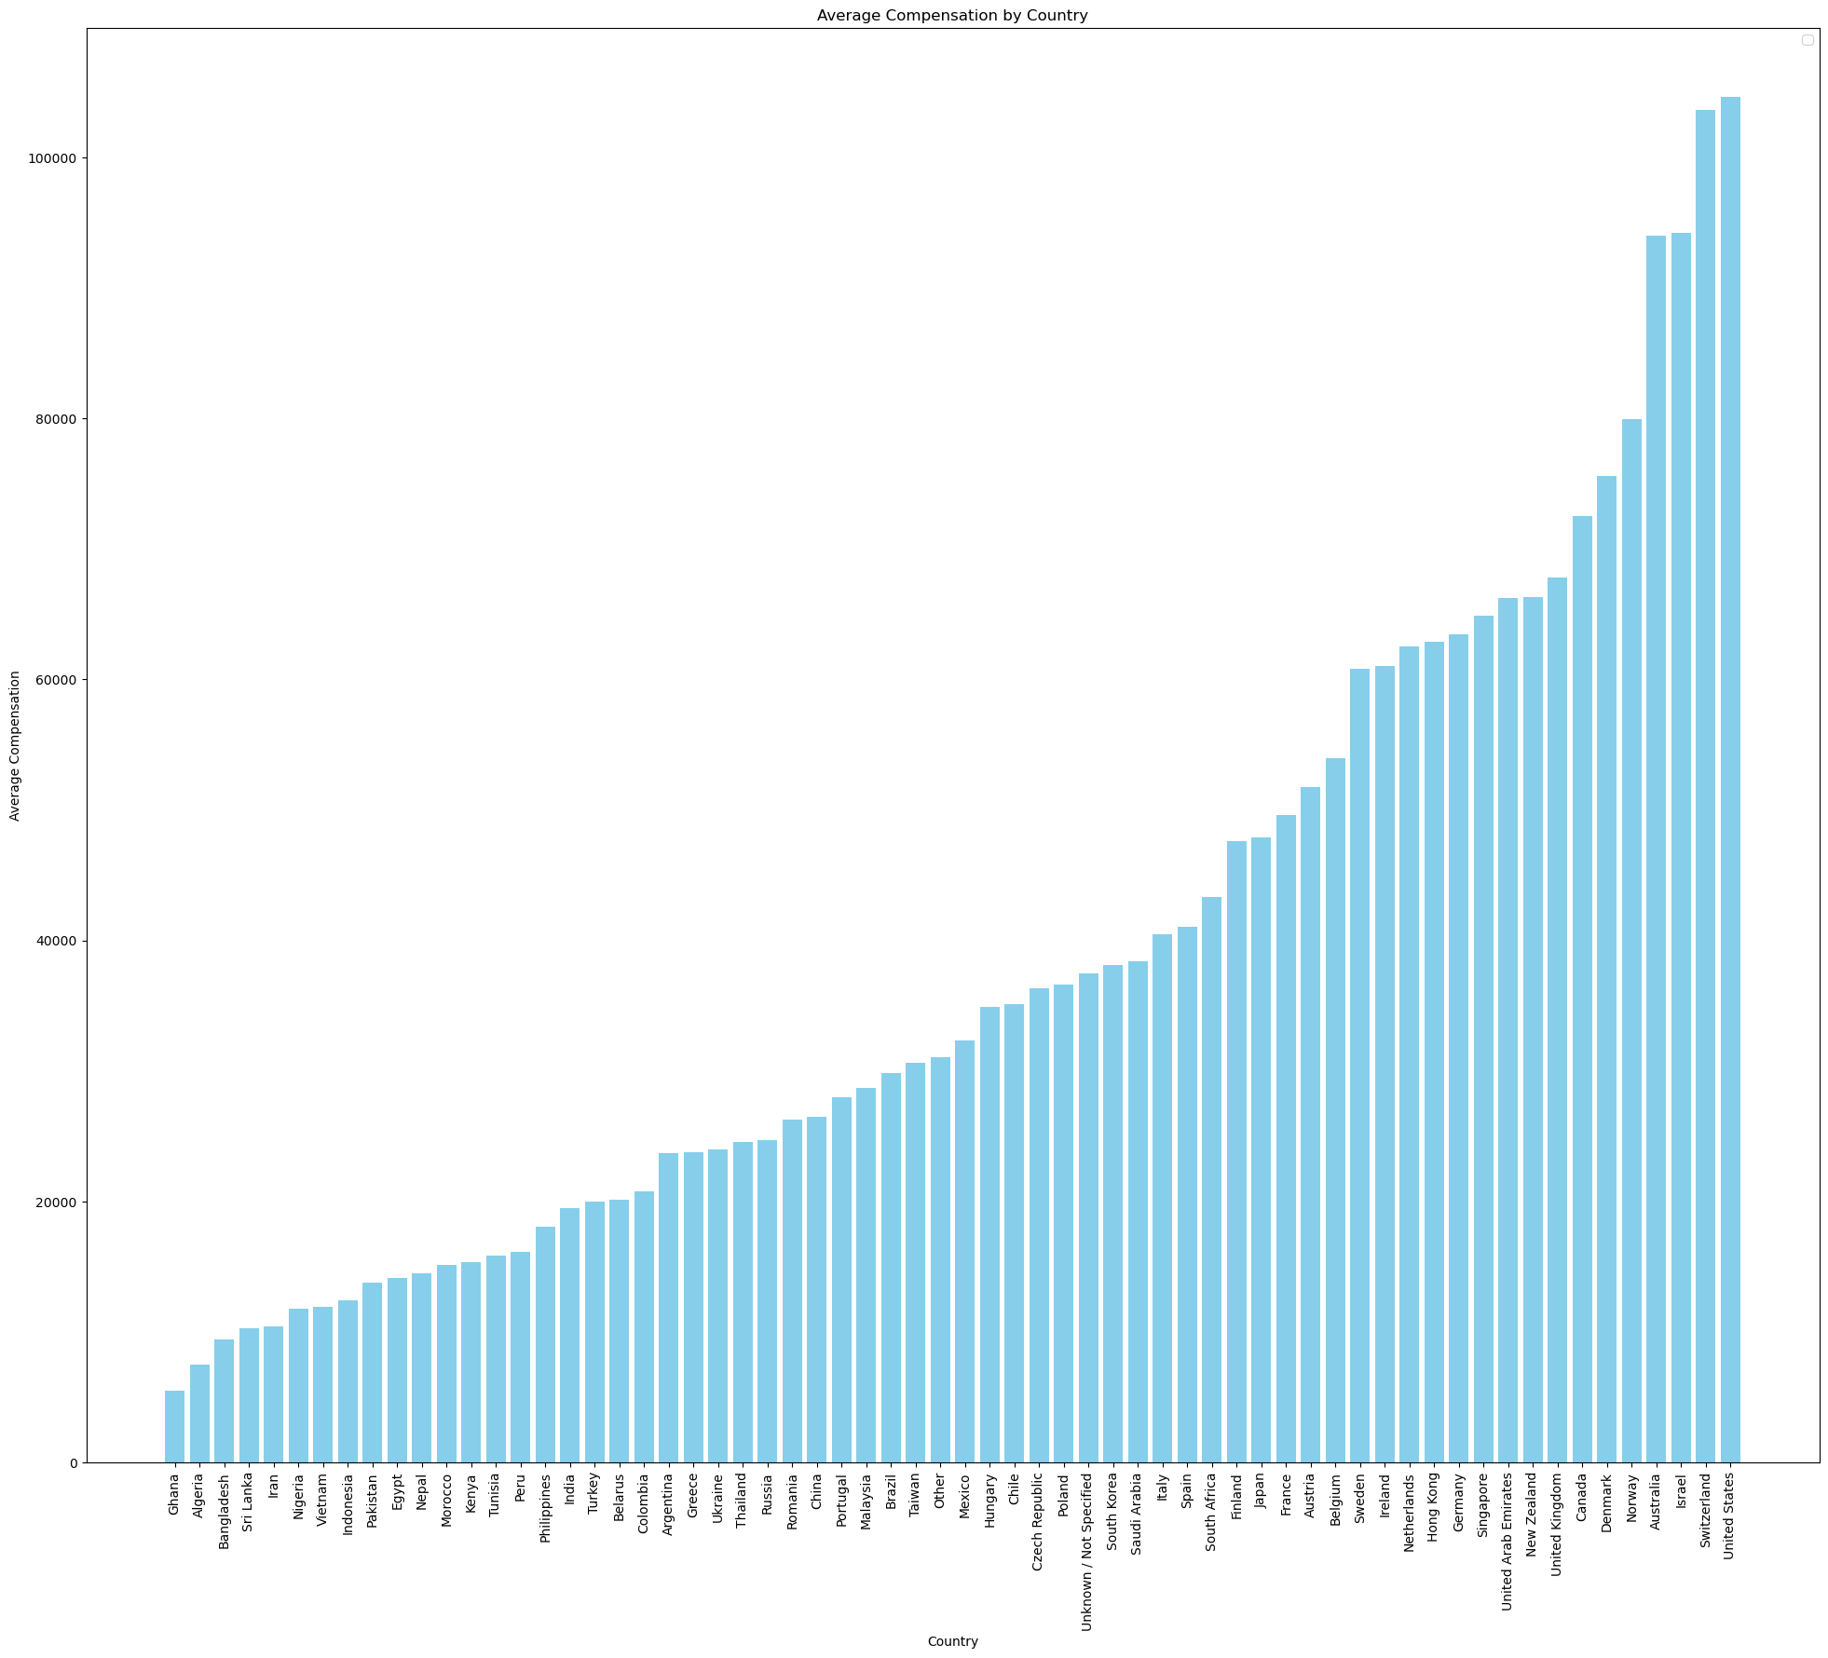
Visualizations and EDA
Average Compensation by Country
More than 100,000
Average Compensation ($)
~8000
Country
Country has a large effect on the total compensation

Slide 11
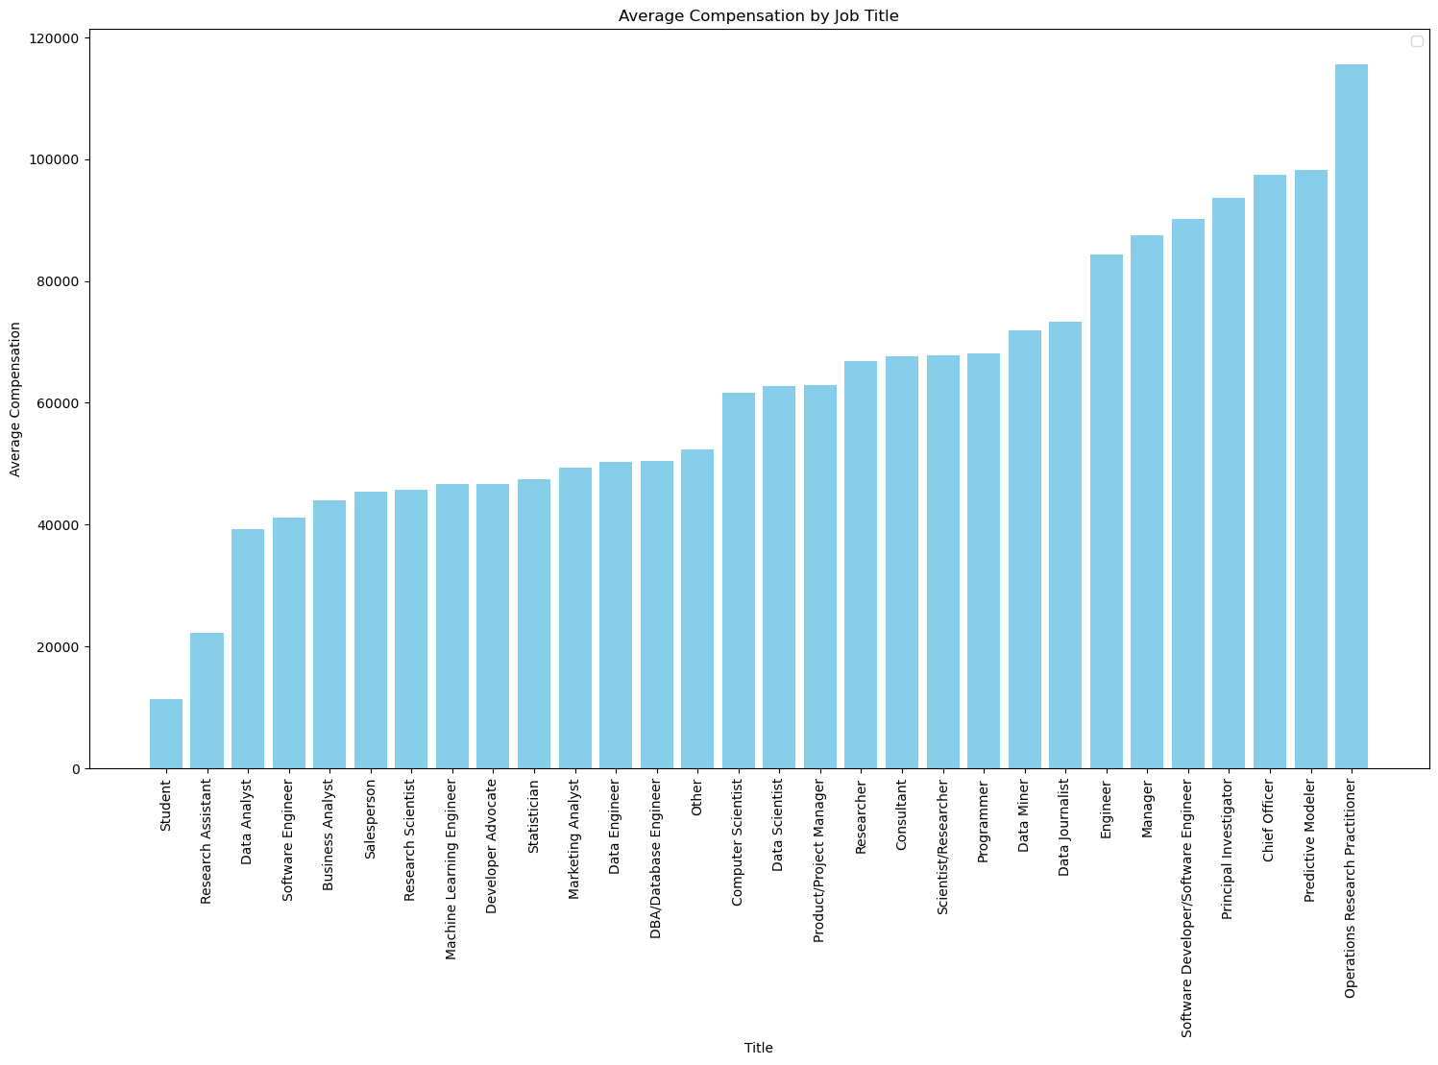
Visualizations and EDA
Average Compensation by Job Title
Average Compensation ($)
Job Title
Student is the lowest paid position, and CEO, Predictive Modeler,
and Operations Research Practitioner are among the highest paid jobs

Slide 12
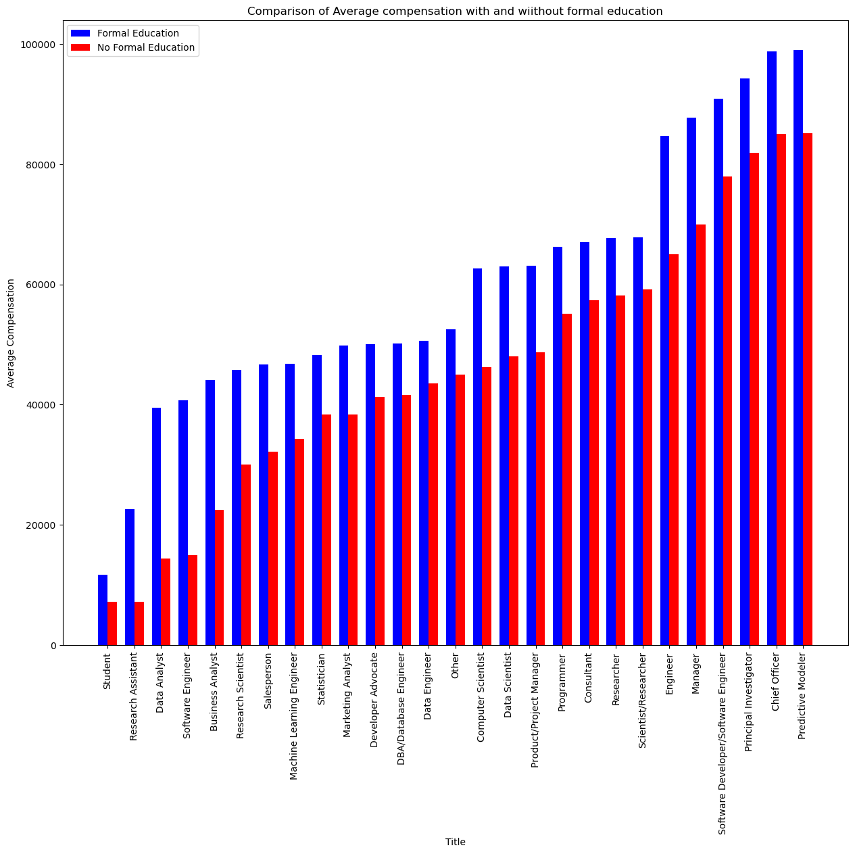
Visualizations and EDA
Average Compensation by Job Title with respect to education status
Average Compensation ($)
Job Title
On average people with the higher education earn more

Slide 13
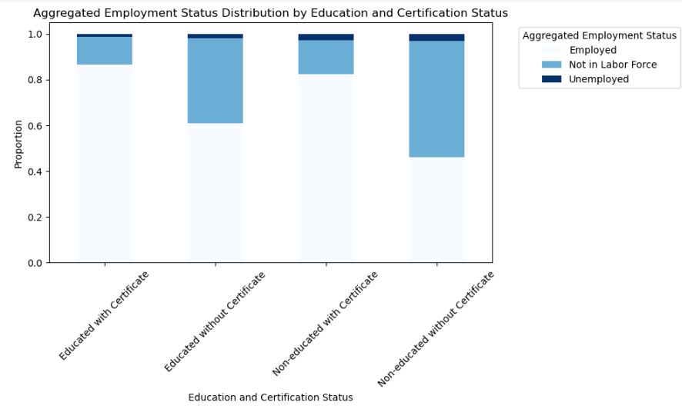
Visualizations and EDA
Non-educated without certificates group has the highest proportion of those not in the labor force

Slide 14
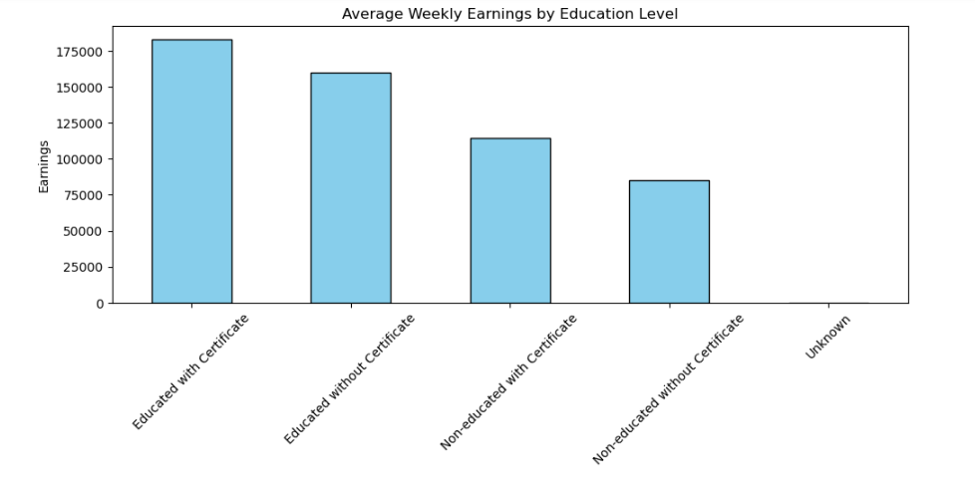
Visualizations and EDA
The earnings drop significantly for non-educated individuals, with those holding certificates earning more than those without

Slide 15
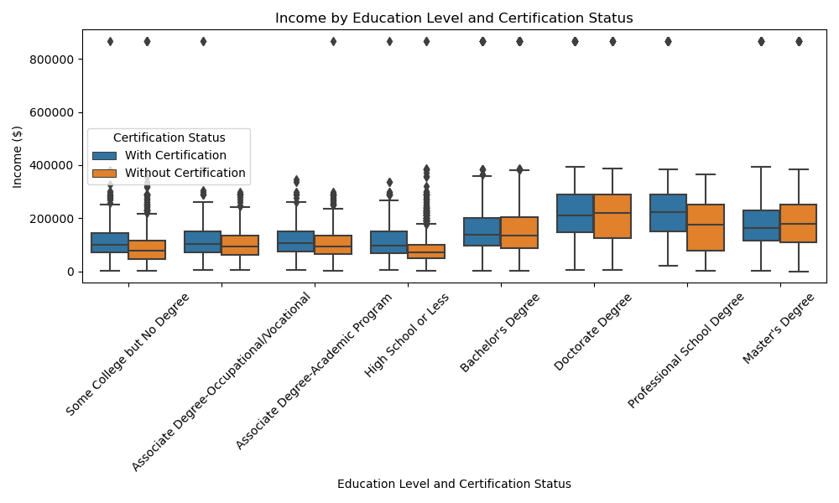
Visualizations and EDA
Except for those with a Doctorate Degree, obtaining a certification enhances your chance of earning a higher income.

Slide 16
Model Selection
Supervised Approach:
-Decision tree
-Random Forest
-XG Boost
Unsupervised approach:
-Uniform Manifold Approximation and Projection for
Dimension Reduction- UMAP
-Hierarchical Density-Based Spatial Clustering of Applications
With Noise- HDBSCAN

Slide 17
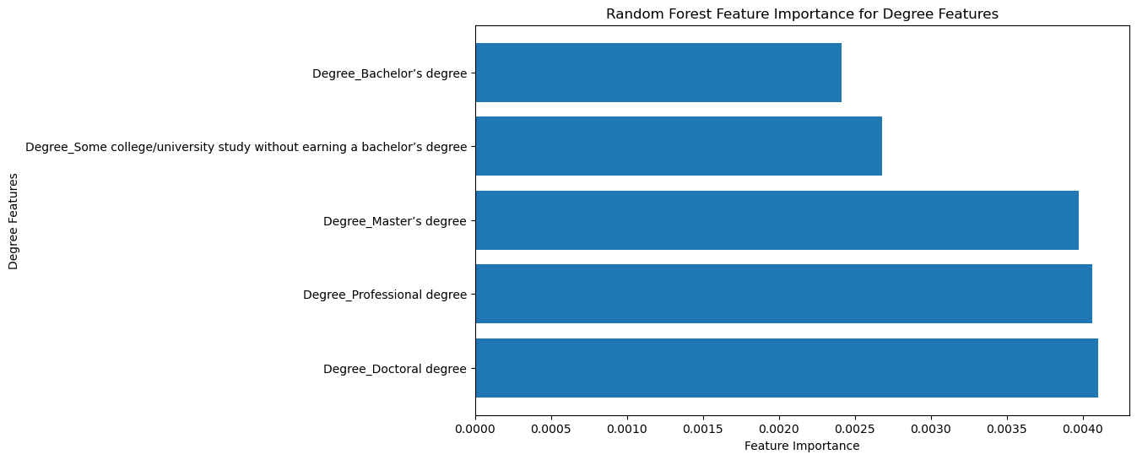
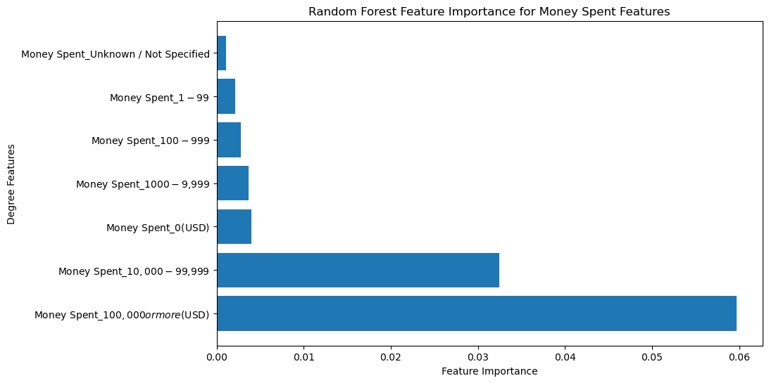
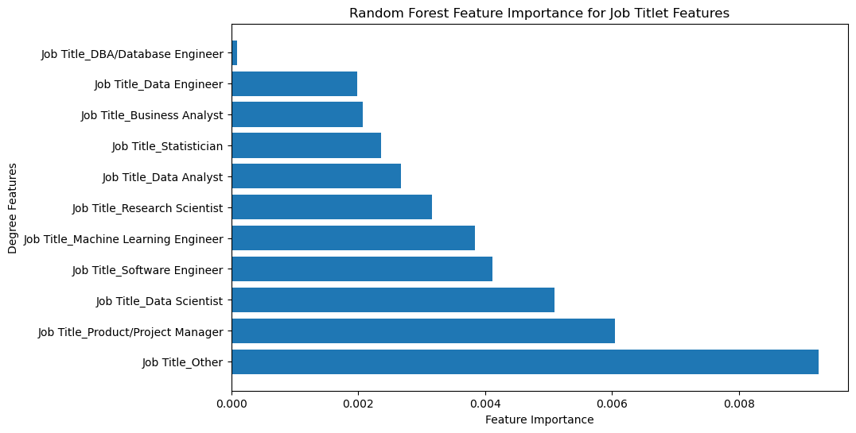
Model Description
Extracted Feature Importance Ranked from the Decision Tree
Fitting 5 folds for each of 1296 candidates, totalling 6480 fits
GridSearchCV(cv=5, estimator=RandomForestRegressor(random_state=42), n_jobs=-1,
param_grid={'max_depth': [None, 10, 40],
'max_features': ['auto', 'sqrt', 'log2'],
'max_leaf_nodes': [None, 10, 30],
'min_impurity_decrease': [0.0, 0.2],
'min_samples_leaf': [1, 2, 4, 5],
'min_samples_split': [2, 20],
'n_estimators': [10, 300, 500]},
scoring='r2', verbose=10)
R-squared value of the RandomForest model with a grid search cross validation is - 0.48223959307287834

Slide 18
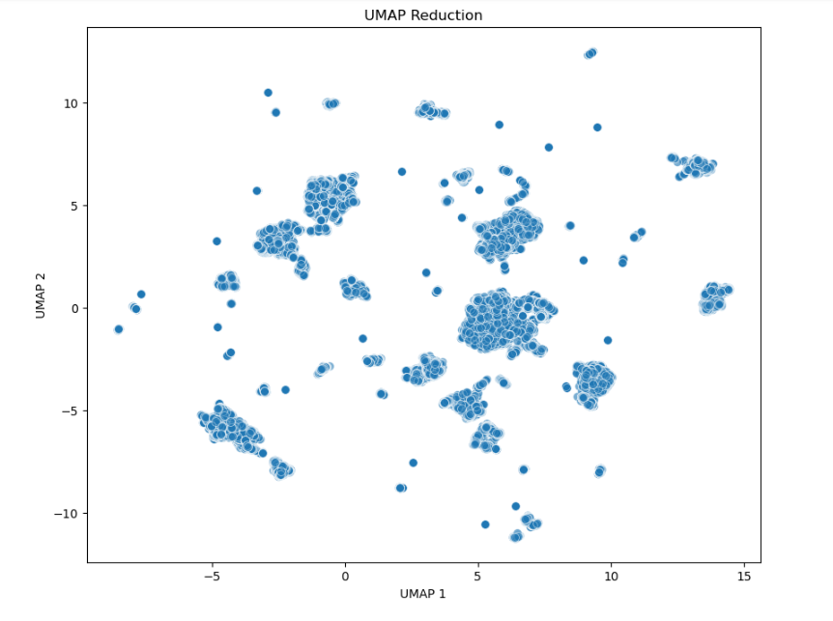
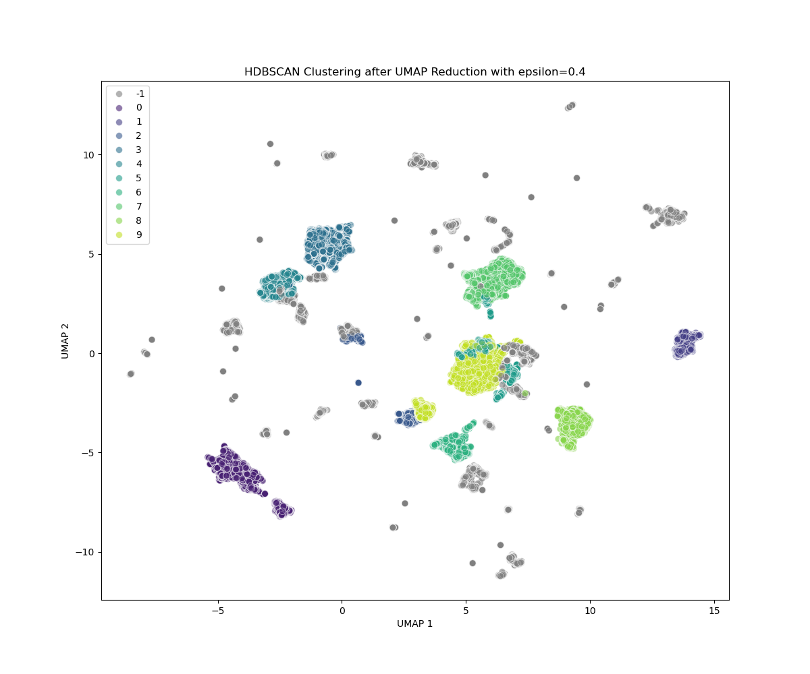
Model Description
.HDBSCAN(min_cluster_size=4000,
min_samples=3000,
cluster_selection_epsilon=0.3)
reducer = umap.UMAP(n_neighbors=50, n_components=7, min_dist=0.0)
Silhouette Score = 0.72

Slide 19
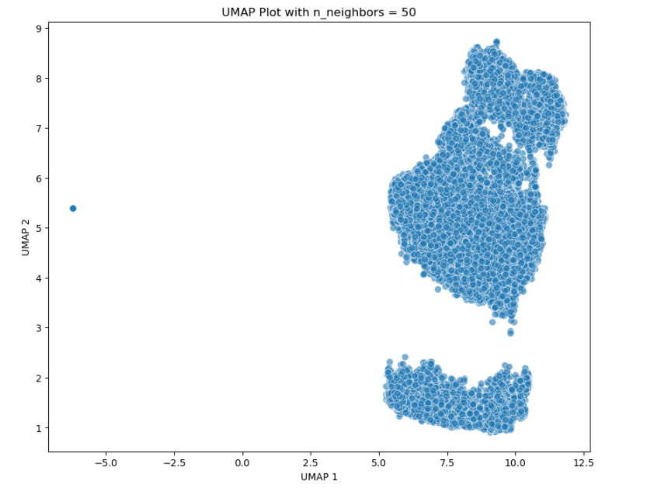
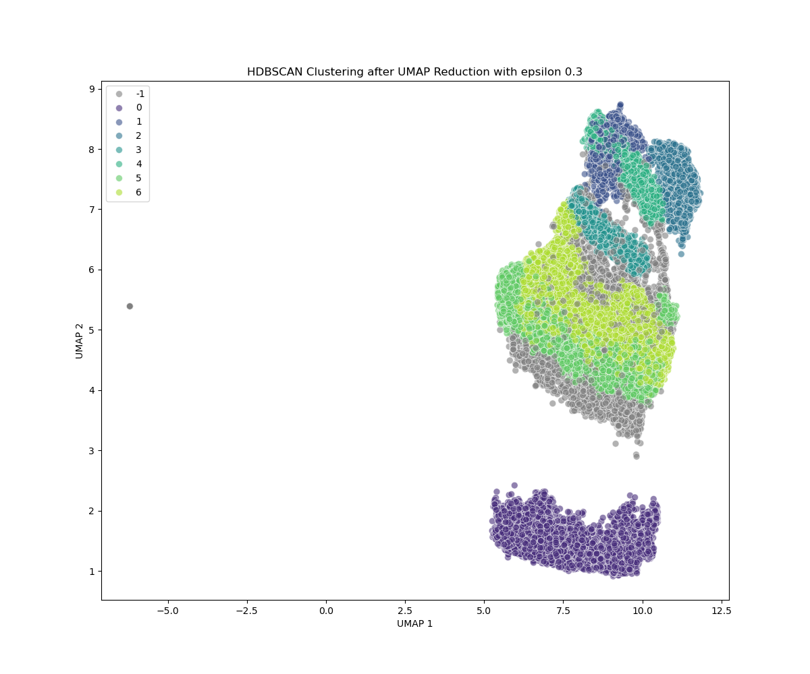
Model Description
Original Features are 389
Remaining Features
- Household Information
- Education and Certification Details
- Employment and Income Details
- Earnings
- State Code
- Work Arrangement and Preferences
- Job Search and Unemployment Details
- Health and Disability
.HDBSCAN(min_cluster_size=4000,
min_samples=3000,
cluster_selection_epsilon=0.3)
reducer = umap.UMAP(n_neighbors=50,
n_components=3,
min_dist=0.0)
Silhouette Score = 0.41

Slide 20
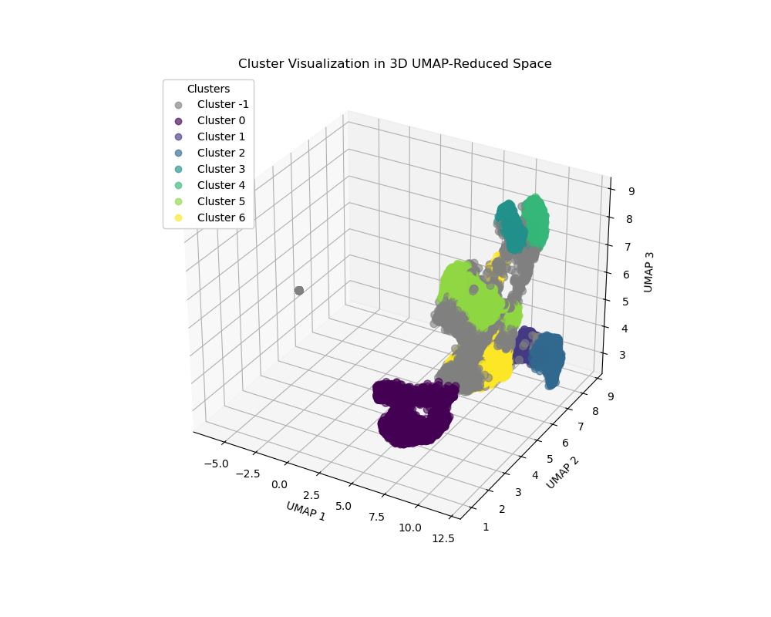
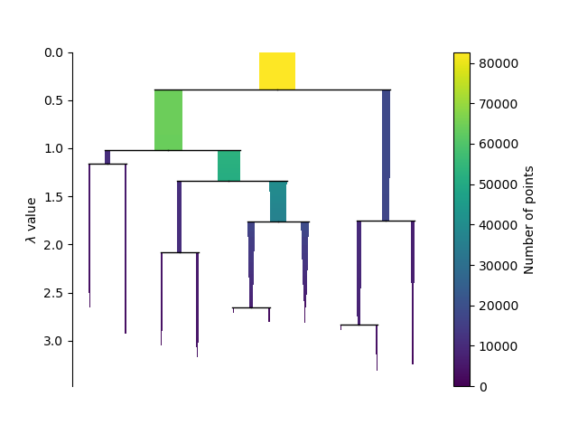
Model Description
This 3D visualization highlights the separation and distinctness among the groups across the three-dimensional UMAP-reduced space
Condensed Tree Plot
The depth and spread of the tree branches represent the cluster stability and the point density within clusters. Deeper, more separated branches indicate a more well-separated cluster

Slide 21
Recommendations and conclusion
The analysis employed both supervised and unsupervised methodologies to reveal insights into the data science labor market.
The supervised approach using the Random Forest model highlighted the significant impact of educational attainment, job titles, and investment in education on salary levels.
Higher education degrees such as Master’s and Doctorates are pivotal in securing higher earnings.
The unsupervised clustering model successfully segmented the labor market into distinct groups, showcasing varying employment statuses and education levels.
This segmentation provides valuable perspectives for career development and strategic education planning.
The combined approaches underscore the complexity of the labor market and the multifaceted nature of salary determinants, offering practical recommendations for optimizing career trajectories in data science.

